Slide 1
DESIGN AND BUILD FRONTEND WEBSITE POPULATION DATA STATISTICS USING PROTOTYPE METHOD
2022
Muhammad Mario Wijatmika
18102097
Supervisor : Pradana Ananda Raharja, S. Kom., M. Kom

Slide 2
Table of contents
01
02
Purpose &
Scope
Introduction
03
04
Theory
Analysis
2022
05
Conclusions &
Suggeestions

Slide 3
01
Introduction
2022

Slide 4

Introduction
2022
PT. Puskomedia Indonesia Kreatif is a company that focuses on digital fields such as making website and mobile-based application products, creating village internet networks, and cloud VPS services. PT. Puskomedia Indonesia Kreatif was founded on 28 September 2013 in Banyumas

Slide 5
Introduction
2022
The village is a legal community unit that is authorized to regulate and manage government affairs and the interests of the residents.
Service to villagers is one of the main factors in governance in urban-village.
The village office needs control over the data that will be submitted to the residents. The website is an example that can make it easier to submit, manage and get data.
The existence of a website-based information system is able to provide data convenience and efficiency. Village officials can process data related to population management and carry out computerized population mapping based on the status of residents
Puskomedia Indonesia Kreatif wants to create a statistical website for population data that it will be used in villages that have collaborated

Slide 6
02
Purpose & Scope
2022

Slide 7
Purpose & Scope
Purpose
facilitate the dissemination of village information
minimize data loss because the data is already stored in a computerized system
Scope
The scope of this research focuses on creating frontend website population data statistics using React JS.

Slide 8
03
Theory
2022

Slide 9
Theory
2022
Website
Website is a combination of web pages, which are summarized in the domain, located on the World Wide Web (WWW) on the internet which contains data, images, text, sound and can be accessed online.
React JS
React JS is an efficient and flexible declarative Javascript library for building website interfaces. React JS can create complex user interfaces with small sets of code called “components”. Features included in React are JSX, Stateful Components, and Virtual Document Object Model

Slide 10
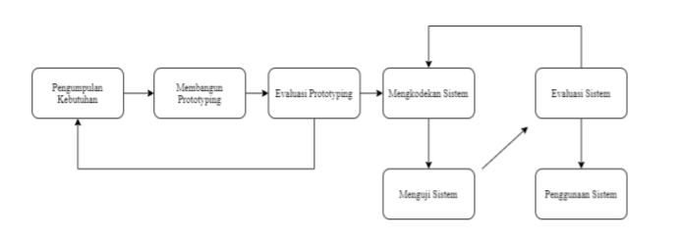
Theory
2022
Prototype Model
The prototype model is a system development technique that uses a prototype to describe the system so that the client or system owner has a clear picture of the system to be built by the development team.

Slide 11
Theory
2022
Black Box Testing
Black Box Testing is a test condition developed on the basis of a program or system function, namely the tester needs information about the observed input and output data, but does not know how the program or system works. tester focuses on testing program functions against these specifications. With black-box testing, the tester views the program as a black box and is completely unconcerned with the internal structure of the program or system.

Slide 12
04
Analysis
2022

Slide 13
2022
Analysis
There are several differences between a website project from campus and a real website project
For example, are the use of programming languages, more complex website features, and more attention to website security
So many feature changes during the development process

Slide 14
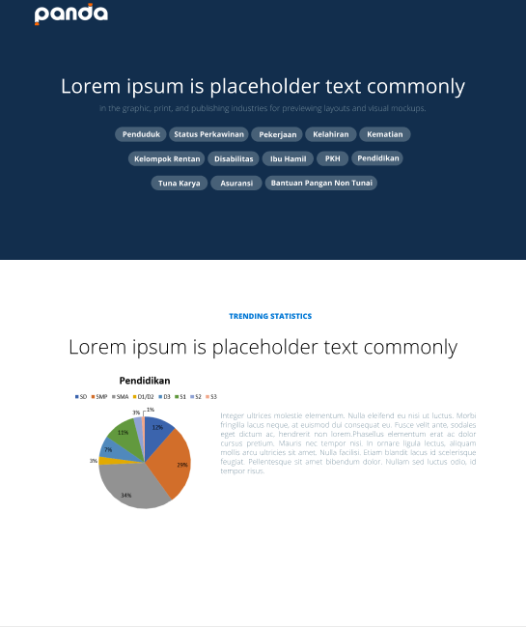
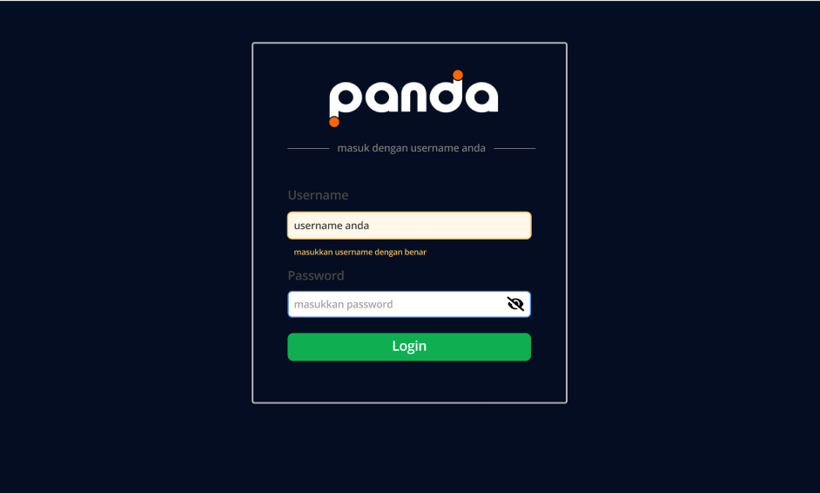
Results
Design – Figma
Home Page
Login Page

Slide 15
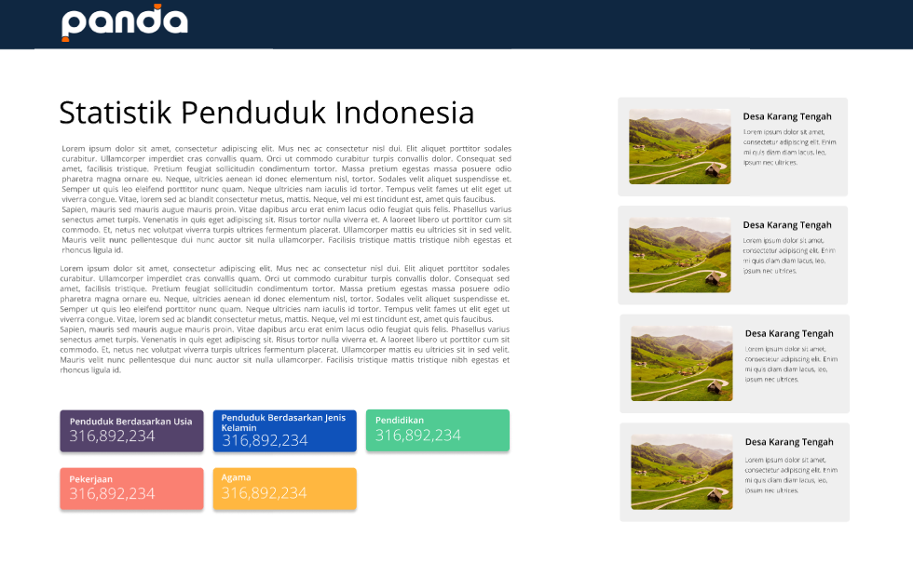
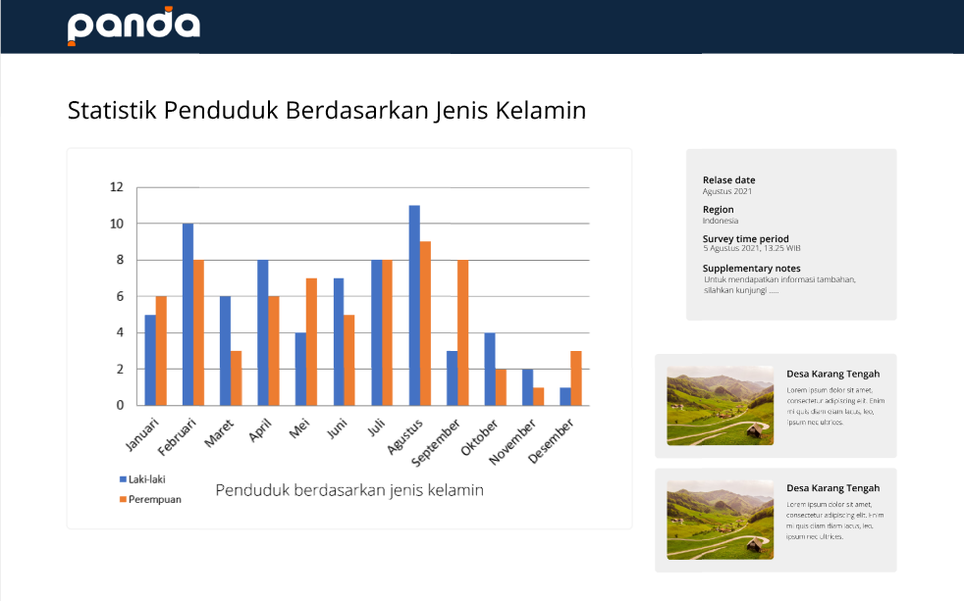
Results
Design – Figma
Category Page
Detail Statistic Page

Slide 16
Work Results
Coding
This stage is the implementation of the system model design that has been made into program code that produces a prototype of the software.

Slide 17
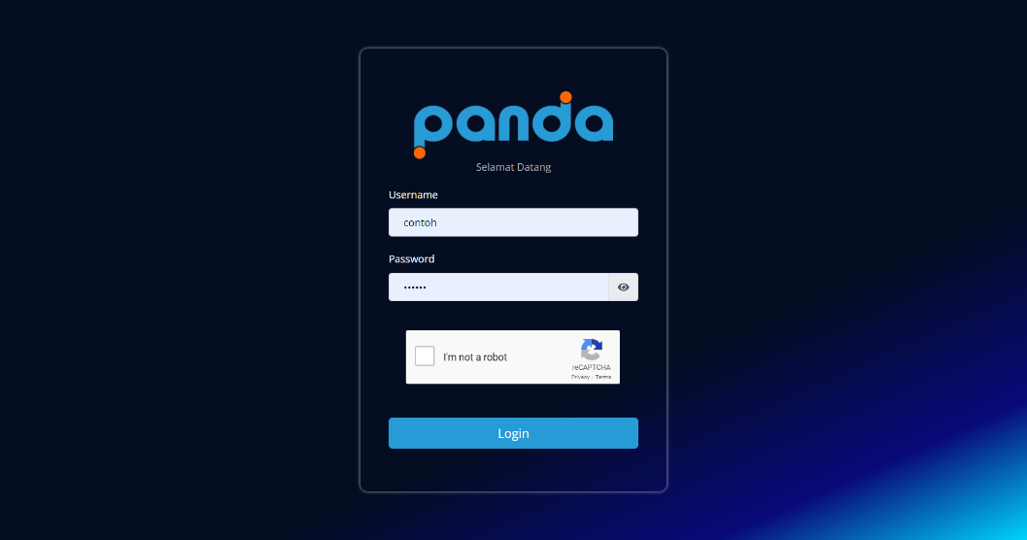
Work Results
Coding – Login Page
in the login page use reCAPTCHA, to make website security strong

Slide 18
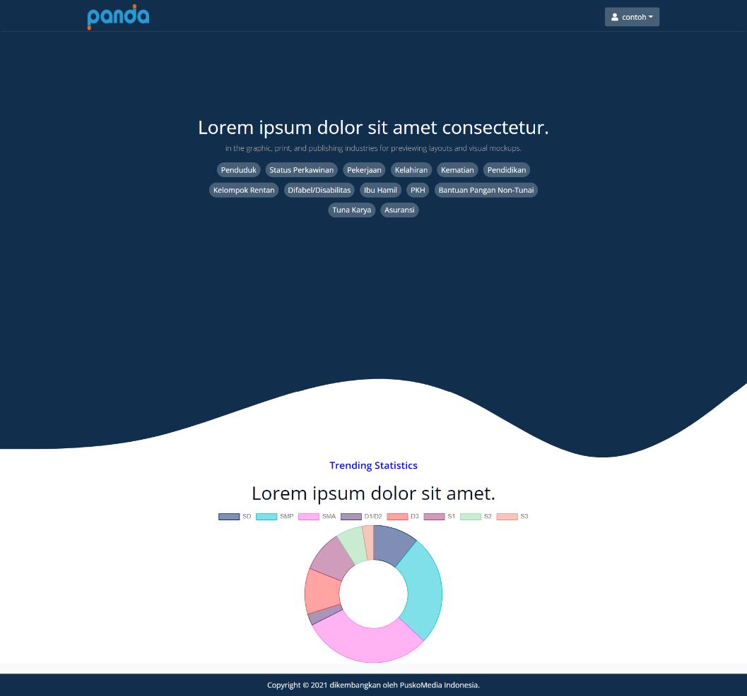
Work Results
Coding – Home Page
in the homepage, there is a button to choice statistical categories

Slide 19
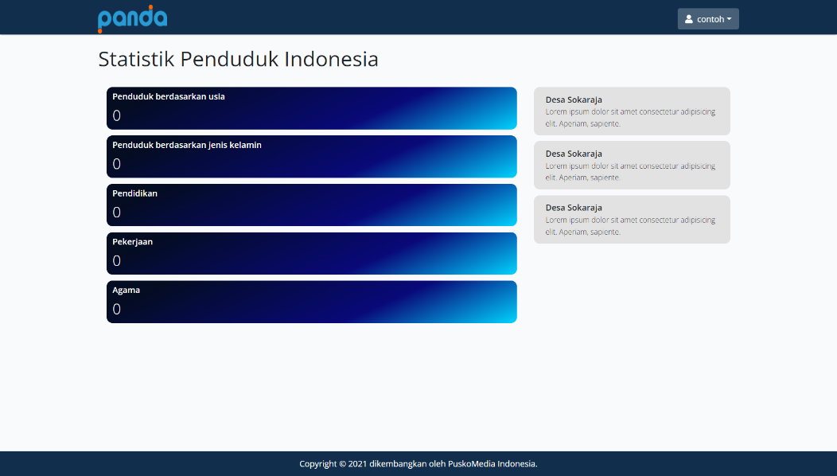
Work Results
Coding – Category Page
in the category page, there is a button to choice sub-categories of statistics

Slide 20
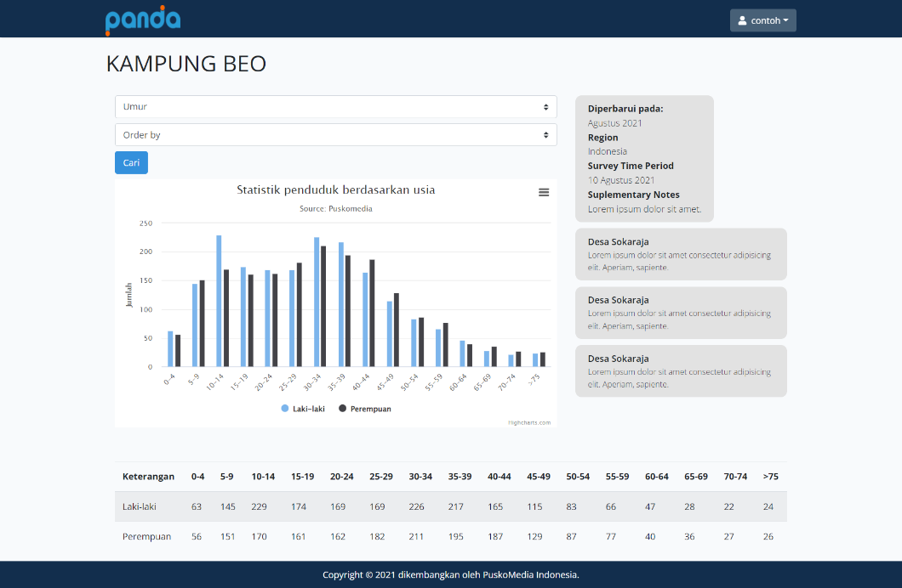
Work Results
Coding – Detail Statistic Page
in the detail statistic page, there are graphs and tables of the population based on the sub-categories selected by the user and there is an option to display statistics based on time

Slide 21
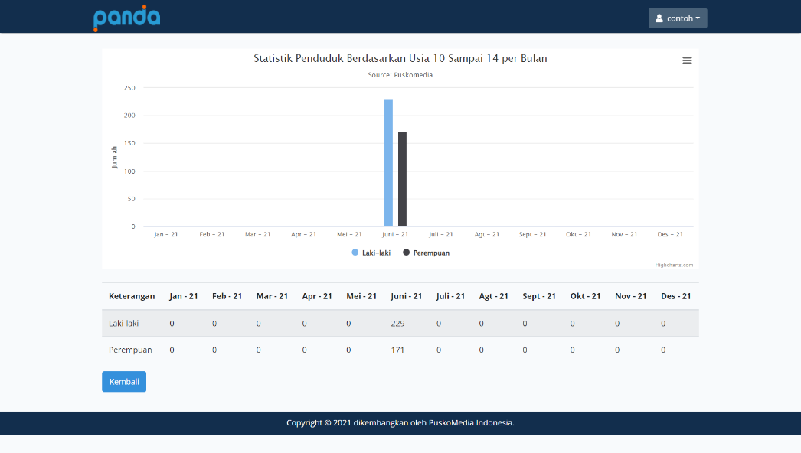
Work Results
Coding – Detailed statistics by time
in the statistical details, there are graphs and tables of the population based on the time selected by the user

Slide 22
Work Results
Testing
At the Testing stage, system testing uses black box testing. This test aims to ensure that the Information System that has been built runs according to the request from the Puskomedia and ensures that there are no errors in the program. This testing method is carried out using several web browsers using a localhost server from laravel.

Slide 23
05
Conclusion & Suggestion
2022

Slide 24
Conclusion & Suggestion
2022
Conclusion
The system can work as expected. Population Data Statistics Website to find out population growth in the village Website security already uses JWT tokens and recaptcha
Suggestion
It is expected that the system will always be developed following the latest technological developments in order to become a powerful system. Tutorial to use of the website must be held for village officials

Slide 25
THANK YOU

